Slide 1
Information Security

Slide 2
Viruses, Bots, and Phish,
Oh My!
What is Information Security?
Why is it Important?
What Can We Do?

Slide 3
Viruses, Bots, and Phish,
Oh My!
What Is Information Security?
Deals with several different "trust" aspects of information and its protection
The U.S. Government’s National Information Assurance Glossary defines INFOSEC as:
    “Protection of information systems against unauthorized access to or modification of information, whether in storage, processing or transit, and against the denial of service to authorized users or the provision of service to unauthorized users, including those measures necessary to detect, document, and counter such threats.”

Slide 4
Viruses, Bots, and Phish,
Oh My!
What Is Information Security?
Three widely accepted elements or areas of focus (referred to as the “CIA Triad”):
  Confidentiality
  Integrity
  Availability (Recoverability)
Includes Physical Security as well as Electronic

Slide 5
Definitions
  Malware:
  Hostile, intrusive, or annoying software or program code ("malicious" + "software“)
  Includes computer viruses, worms, trojan horses, bots, spyware, adware, etc
  Software is considered malware based on the intent of the creator rather than any particular features

Slide 6
Definitions
  Internet bot:
  also known as web robots, are automated internet applications controlled by software agents
  These bots interact with network services intended for people, carrying out monotonous tasks and behaving in a humanlike manner (i.e., computer game bot)
  Bots can gather information, reply to queries, provide entertainment, and serve commercial purposes.
  Botnet - a network of "zombie" computers used to do automated tasks such as spamming or reversing spamming

Slide 7
Definitions
  Adware:
  Advertising-supported software is any software package which automatically plays, displays, or downloads advertising material to a computer after the software is installed on it or while the application is being used.
  Adware is software integrated into or bundled with a program, typically as a way to recover programming development costs through advertising income

Slide 8
Definitions
  Spyware:
  A broad category of software designed to intercept or take partial control of a computer's operation without the informed consent of that machine's owner or legitimate user
  In simpler terms, spyware is a type of program that watches what users do with their computer and then sends that information over the internet

Slide 9
Definitions
  Spyware:
  Spyware can collect many different types of information about a user:
    Records the types of websites a user visits
    Records what is typed by the user to intercept passwords or credit card numbers
    Used to launch “pop up” advertisements
  Many legitimate companies incorporate forms of spyware into their software for purposes of advertisement(Adware)

Slide 10
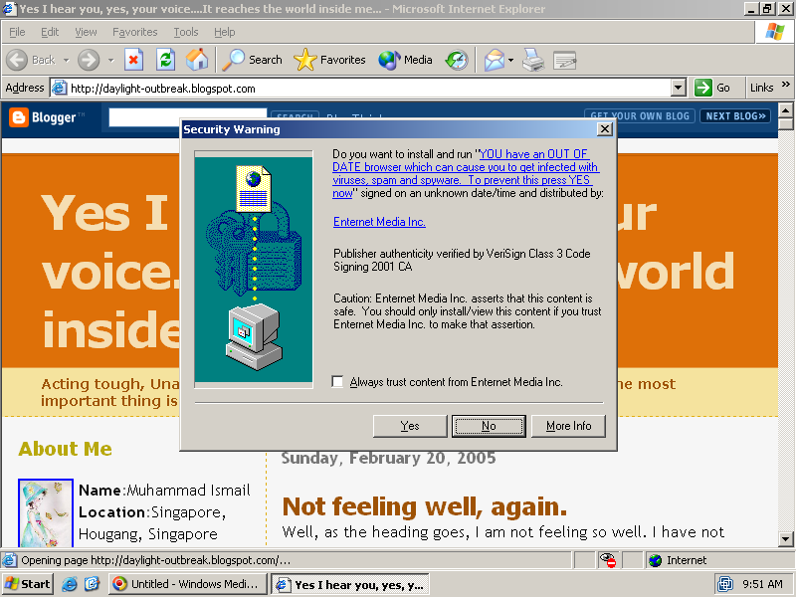
Spyware Example

Slide 11
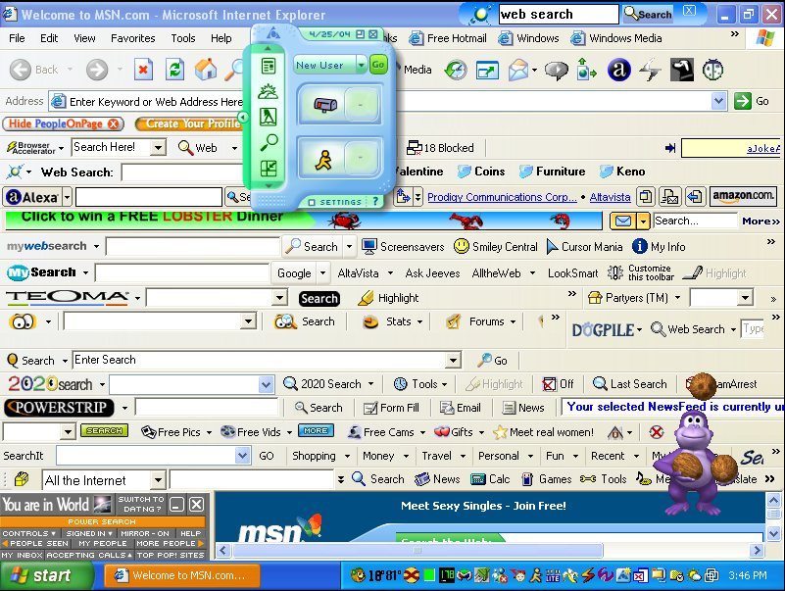
Spyware Example
(add-on toolbars)

Slide 12
Definitions
  Spam:
  Spamming is the abuse of electronic messaging systems to send unsolicited, undesired bulk messages
  Spam media includes:
    e-mail spam (most widely recognized form)
    instant messaging spam
    Usenet newsgroup spam
    Web search engine spam
    spam in blogs
    mobile phone messaging spam

Slide 13
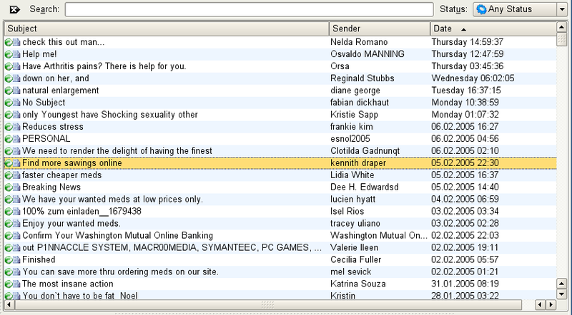
Spam Example

Slide 14
Definitions
  Phishing:
  A criminal activity using social engineering techniques.
  An attempt to acquire sensitive data, such as passwords and credit card details, by masquerading as a trustworthy person or business in an electronic communication.
  Typically carried out using email or an instant message

Slide 15
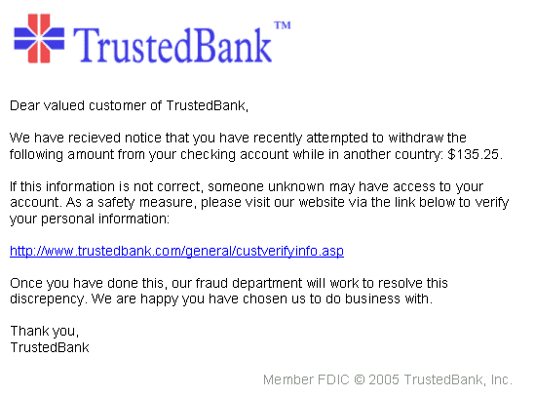
Phishing Example
Points to “bad” IP Address!

Slide 16
Definitions
  Keystroke Logging:
  Keystroke logging (often called keylogging) is a diagnostic used in software development that captures the user's keystrokes
    Useful to determine sources of error in computer programs
    Used to measure employee productivity on certain clerical tasks
  Highly useful for law enforcement and espionage
    Obtain passwords or encryption keys and thus bypassing other security measures
  Widely available on the internet and can be used by anyone for the same purposes

Slide 17
Definitions
  Keystroke Logging:
  Can be achieved by both hardware and software means
  Hardware key loggers are commercially available devices which come in three types:
    Inline devices that are attached to the keyboard cable
    Devices installed inside standard keyboards
    Keyboards that contain the key logger already built-in
  Writing software applications for keylogging is trivial, and like any computer program can be distributed as malware (virus, trojan, etc.)

Slide 18

Keylogger Example
In-line hardware Keylogger

Slide 19
Viruses, Bots, and Phish,
Oh My!
Why is it Important?
Over the last two years, the IT security threat landscape has changed significantly.
Traditional malware threats hit an apparent wall in 2005
However new threats (bots, spam, phishing) have stepped into the void.
Remember the objective - the “CIA Triad” :
  Confidentiality
  Integrity
  Availability (Recoverability)

Slide 20
Viruses, Bots, and Phish,
Oh My!
Why is it Important?
Unauthorized access (malware, spyware) limits our ability to protect the confidentiality of the data
Malicious programs can alter the data values, destroying the integrity of the data
Denial of Service (DoS) attacks can shut down a server and/or network, making the system unavailable.
Efforts to correct costs corporations time and money!

Slide 21
Viruses, Bots, and Phish,
Oh My!
Why is it Important?
There were on average over eight million phishing attempts per day during the latter half of 2005 (Symantec)
The California legislature found that spam cost United States organizations alone more than $10 billion in 2004, including lost productivity and the additional equipment, software, and manpower needed to combat the problem.

Slide 22
Viruses, Bots, and Phish,
Oh My!
Why is it Important?
Regulatory Issues:
  HIPAA (electronic personal identifiable information)
  Sarbanes-Oxley Act (federal securities law focused on data accuracy and integrity)
  PCI Security (Payment Card Industry security measures)
Potential/Growing Issues:
  Liability for damage caused by bot-nets
  Loss of corporate confidential information (financials, personnel)
  Electronic Blackmail

Slide 23
Viruses, Bots, and Phish,
Oh My!
What Can We Do?
Security Assessment
  Identify areas of risk
  Identify potential for security breaches, collapses
  Identify steps to mitigate
Security Application
  Expert knowledge (train, hire, other)
  Multi-layered Approach (there is no single solution)
  Policies and Procedures

Slide 24
Viruses, Bots, and Phish,
Oh My!
What Can We Do?
Security Awareness
  Not just for the geeks!
  Security Training at all levels (external and/or internal)
  Continuing education and awareness – not a one-time shot!
  Make it part of the culture

Slide 25
Viruses, Bots, and Phish,
Oh My!
Key Takeaways:
Objective of InfoSec is Confidentiality, Integrity and Availability…protect your systems and your data
Threats are numerous, evolving, and their impact is costly
Security should be applied in layers (“road blocks”)
Security Awareness at all levels must be maintained
Failure to Secure is an Opportunity to Fail

Slide 26
Information Security
Questions?

